Slide 1


Object Oriented Programming
Nilesh Shirude
E&TC Department
PICT Pune

Slide 2
Object Oriented Programming
UNIT :- II
Classes and Objects in JAVA

Slide 3
CO and PO Mapping
Unit No. 2 | CO No 2 | Attainment
Classes and Objects | Define concepts of classes, objects, methods, constructors and implement method and constructor overloading | Unit Test I
CO | PO1 | PO2 | PO3 | PO4 | PO5 | PO6 | PO7 | PO8 | PO9 | PO10 | PO11 | PO12 | PSO1 | PSO2 | PSO3
CO2 | 3 | 3 | 2 | 2 | - | - | - | 1 | - | 1 | - | 3 | - | 2 | -

Slide 4
Syllabus
Class Fundamentals, Declaring Objects, Assessing class members, Assigning Object reference variables, Methods
The This keyword, Garbage collection, finalize method, Overloading methods, using objects as parameters, Argument passing, returning objects,
Recursion, access control, static, final, arrays

Slide 5
Outline
Introduction
Defining a class
Fields declaration
Methods declaration
Creating objects
Accessing class members
Constructors
Method Overloading
Static Members
Nesting of methods

Slide 6
Introduction
Object-Oriented Programming or OOPs refers to languages that use objects in programming, they use objects as a primary source to implement what is to happen in the code.
The main aim of OOP is to bind together the data and the functions that operate on them so that no other part of the code can access this data except that function.

Slide 7
OOP
OOPS concepts are as follows:
Class
Object
Method and method passing
Pillars of OOPs
Abstraction
Encapsulation
Inheritance
Polymorphism
Compile-time polymorphism
Runtime polymorphism

Slide 8
Class
Java programmers consist of classes.
Class is a group of object, which have a common properties
It is a template or blueprint from which objects are created
Class defines the state and behaviour of its objects.
So classes creates objects and objects uses methods to communicate between them.
In class we have logically related data items and functions group together.
In java, the data items are called fields and functions are called methods

Slide 9
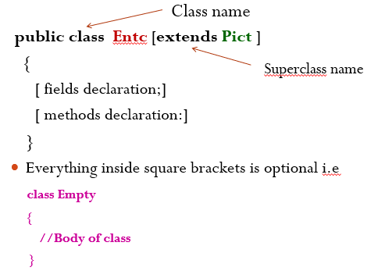
Defining a Class

Slide 10
Class Declaration Components
Modifiers: A class can be public or have default access
Class name: The class name should begin with the initial letter capitalized by convention.
Superclass (if any): The name of the class’s parent (superclass), if any, preceded by the keyword extends. A class can only extend (subclass) one parent.
Interfaces (if any): A comma-separated list of interfaces implemented by the class, if any, preceded by the keyword implements. A class can implement more than one interface.
Body: The class body is surrounded by braces, { }.

Slide 11
Declaration of Fields (Data Members)
Field is nothing but data member.
Ex:
class rectangle
{
int length;
int width;
}
Here length and width are nothing but the data members or fields or instance variables or member variables

Slide 12
Declaration of Methods
Methods are declared inside the body of class for manipulating the data (field) contained in that class.
Method is nothing but member function of class in C++
The syntax for method declaration is
return type method name ( parameter- list)
{
method-body;
}
Method definition have four basic parts
Name of method
Type of value the method returns
List of parameters
body of method

Slide 13
Method Components
The return type: The data type of the value returned by the method or void if it does not return a value.
Method Name: The rules for field names apply to method names as well, but the convention is a little different.
Parameter list: Comma-separated list of the input parameters that are defined, preceded by their data type, within the enclosed parentheses. If there are no parameters, you must use empty parentheses ().
Exception list: The exceptions you expect the method to throw. You can specify these exception(s).
Method body: It is the block of code, enclosed between braces, that you need to execute to perform your intended operations.

Slide 14
Method Components
Access Modifier: Defines the access type of the method i.e. from where it can be accessed in your application. In Java, there are 4 types of access specifiers:
public: Accessible in all classes in your application.
protected: Accessible within the package in which it is defined and in its subclass(es) (including subclasses declared outside the package).
private: Accessible only within the class in which it is defined.
default (declared/defined without using any modifier): Accessible within the same class and package within which its class is defined.

Slide 15
Access Modifiers in JAVA
As the name suggests access modifiers in Java helps to restrict the scope of a class, constructor, variable or data member, method, .
There are four types of access modifiers available in java:
Default – No keyword required
Private
Protected
Public

Slide 16
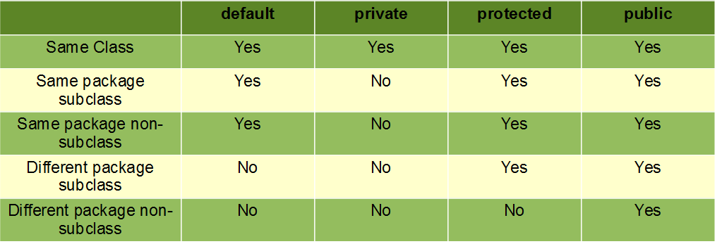
Access Modifiers in JAVA

Slide 17
Access Modifiers in JAVA
Top-level classes or interfaces can not be declared as private and protected because
private means “only visible within the enclosing class”.
protected means “only visible within the enclosing class and any subclasses”
Hence these modifiers in terms of application to classes, apply only to nested classes and not on top-level classes

Slide 18
Class Example
class Rectangle
{ int length;
int width;
void getdata(int x, int y) // method declaration
{
length=x;
width=y;
}
int rectarea() // declaration of method to calculate area
{
int area = length * width;
return(area);
}
}

Slide 19
Class Example
Instance variables and methods in classes are accessible by all the methods in the class, but a method cannot access the variables declared in other methods.
Ex
class Access
{int x;
void method1()
{int y;
x=3;
y=x;
}
void method2()
{
int z;
x=7;
z=10;
y=4;
}
}

Slide 20
Objects
It is a basic unit of Object-Oriented Programming and represents real life entities.
A typical Java program creates many objects, which as you know, interact by invoking methods.
An object consists of :
State: It is represented by attributes of an object. It also reflects the properties of an object.
Behavior: It is represented by methods of an object.
Identity: It gives a unique name to an object and enables one object to interact with other objects.

Slide 21
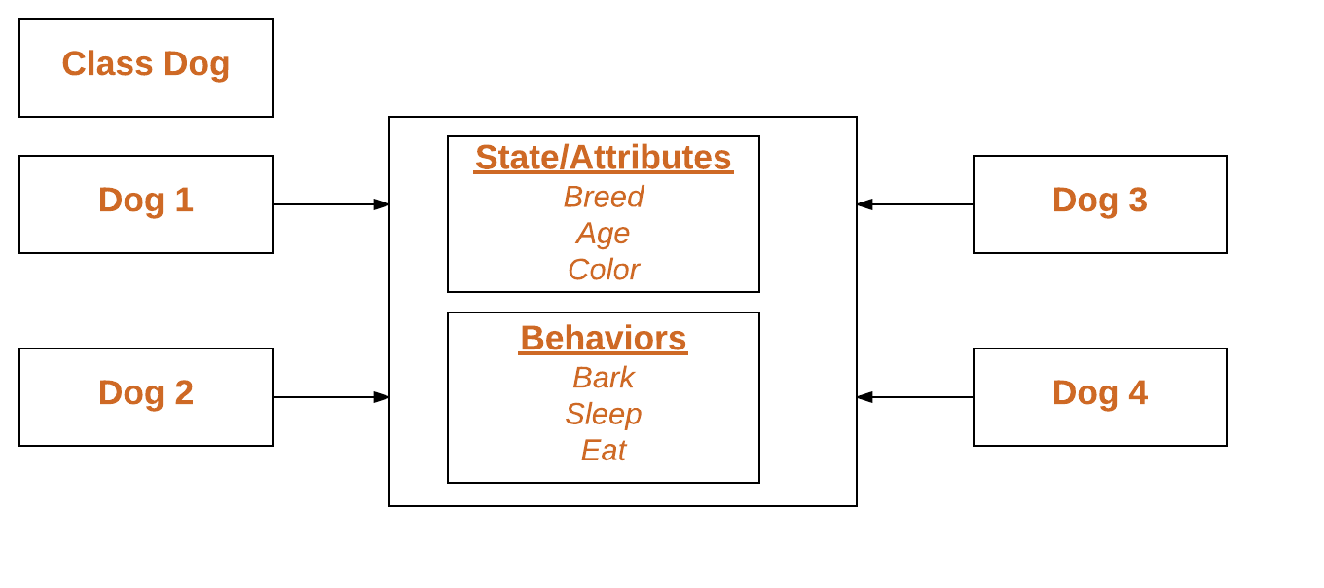
Objects Example

Slide 22
Creating objects
Creating an object is also referred to as instantiating an object.
Objects in java are created using the new operator.
The new operator creates object of the specified class and returns a reference to that object.
Ex:
Rectangle rect1;
rect1 = new Rectangle();
The first statement declares a variable to hold the object reference
second statement actually assigns the object reference to the variable.

Slide 23
Both the statements of object creation are combined into one as shown:
Rectangle rect1 = new Rectangle();
Action Statement Result
Rectangle rect1; rect1
rect1= new Rectangle(); rect1
Declare
null
Instantiate
rect1 is a reference to Rectangle object
Rectangle object

Slide 24
It is also possible to create two or more references to the same object
Rectangle R1= new Rectangle ();
Rectangle R2=R1;
R1
R2
Rectangle object

Slide 25
Accessing class members
objectname.variablename = value;
objectname.methodname(parameter-list);
Syntax is
class Rectarea
{ public static void main(String args[])
{ int area1, area2;
Rectangle rect1= new Rectangle();
Rectangle rect2= new Rectangle();
rect1.length=10;
rect1.width = 15;
rect2.getData(20,15);
area1= rect1.length*rect1.width;
area2 = rect2.rectArea();
System.out.println(area1);
System.out.println(area2); }
class Rectangle
{int length, width;
void getData(int x, int y)
{length = x;
width = y;}
int rectArea()
{int area = length * width;
return(area);}
}

Slide 26
More about JAVA

Slide 27
This keyword
In java, this is a reference variable that refers to the current object
Usage of java this keyword
1. this can be used to refer current class instance variable.
2. this can be used to invoke current class method (implicitly)
3.this() can be used to invoke current class constructor.

Slide 28
1) this: To refer current class instance variable
class Student
{
int rollno;
String name;
float fee;
Student(int rollno,String name,float fee)
{
rollno=rollno;
name=name;
fee=fee;
}
public void display()
{ System.out.println(rollno+" "+name+" "+fee);
}
}
class Test
{
public static void main(String args[])
{
Student s1=new Student(111,"ankit",5000f);
Student s2=new Student(112,"sumit",6000f);
s1.display();
s2.display();
}
}

Slide 29
1) this: To refer current class instance variable
class Student
{
int rollno;
String name;
float fee;
Student(int rollno,String name,float fee)
{
this.rollno=rollno;
this.name=name;
this.fee=fee;
}
public void display()
{
System.out.println(rollno+" "+name+" "+fee);
}
}
class Test
{
public static void main(String args[])
{
Student s1=new Student(111,"ankit",5000f);
Student s2=new Student(112,"sumit",6000f);
s1.display();
s2.display();
}
}

Slide 30
this: To invoke current class method
class A
{
public void m()
{
System.out.println("hello m");
}
public void n()
{
System.out.println("hello n");
m();
}
}
class Test{
public static void main(String args[])
{
A a=new A();
a.n();
}
}
class A{
public void m()
{
System.out.println("hello m");
}
public void n()
{
System.out.println("hello n");
this.m();
}
}
class Test
{
public static void main(String args[])
{
A a=new A();
a.n();
}
}

Slide 31
3) this() : To invoke current class constructor
Calling default constructor from parameterized constructor:
class A
{
A()
{
System.out.println("hello a");
}
A(int x)
{
this();
System.out.println(x);
}
}
class Test
{
public static void main(String args[])
{
A a=new A(10);
}
}

Slide 32
Calling parameterized constructor from default constructor:
class A{
A()
{
this(5);
System.out.println("hello a");
}
A(int x)
{
System.out.println(x);
}
}
class Test
{
public static void main(String args[]){
A a=new A();
}
}

Slide 33
Final Keyword
The final keyword in java is used to restrict the user. The java final keyword can be used in many context. Final can be:
1. variable
2. method
3. class

Slide 34
1) Java final variable
If you make any variable as final, you cannot change the value of final variable(It will be constant).
class Bike
{
final int speedlimit=90; //final variable
void run()
{
speedlimit=400;
}
public static void main(String args[])
{
Bike obj=new Bike();
obj.run();
}
}
Output: Compile time error

Slide 35
2) Java final method
If you make any method as final, you cannot override it.
class Bike
{
final void run()
{
System.out.println(“Bike");
}
}
class Honda extends Bike
{
void run()
{
System.out.println(“Honda");
}
public static void main(String args[])
{
Honda honda= new Honda();
honda.run();
}
}

Slide 36
Q) Is final method inherited?
Yes, final method is inherited but you cannot override it.
class Bike
{
final void run()
{
System.out.println("running...");
}
}
class Honda extends Bike
{
public static void main(String args[])
{
Honda H= new Honda()
H.run();
}
}

Slide 37
Final parameter
If you declare any parameter as final, you cannot change the value of it.
class Bike
{
int cube(final int n)
{
n=n+2;//can't be changed as n is final
n*n*n;
}
public static void main(String args[])
{
Bike b=new Bike();
b.cube(5);
}
}

Slide 38
Remaining Topic
Garbage collection
finalize method
using objects as parameters, Argument passing, returning objects
recursion
Command line arguments

Slide 39
Garbage collector (Object Destruction )
In java, garbage means unreferenced objects.
When object is create using the dynamic operator new, memory is allocated for it from heap region.
So to destroy the object we were using free() function in C language and delete() in C++. But, in java it is performed automatically.
Garbage Collection is process of reclaiming the runtime unused memory automatically. In other words, it is a way to destroy the unused objects or unreachable objects.
Unreachable Objects:- Object said to be unreachable if it does not contain any reference to it.

Slide 40
Advantage of Garbage Collection
It makes java memory efficient because garbage collector removes the unreferenced objects from heap memory.
It is automatically done by the garbage collector(a part of JVM) so we don't need to make extra efforts.

Slide 41
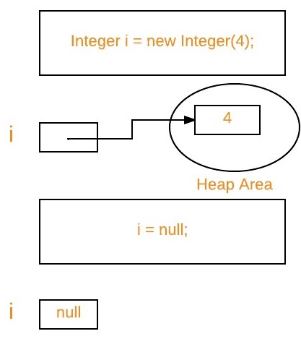
How can an object be unreferenced?
1. By nulling a reference:
Integer i=new Integer(4); // new integer object is reachable via the reference in ‘i’
i=null; // integer object is not reachable longer

Slide 42
2) By assigning a reference to another:
Employee e1=new Employee();
Employee e2=new Employee();
e2=e1;
//now the first object referred by e1 is available for garbage
collection

Slide 43
Way of Requesting JVM to Run Garbage Collector
Once we made object eligible for garbage collection , it may not be destroy immediately by garbage collector
Whenever JVM runs garbage collector program, then only object will be destroyed. But when JVM run the garbage collector , we can not expect.
We can also request JVM to run garbage collector
Using System.gc() method : System class contain static method gc() for requesting JVM to run Garbage Collector.

Slide 44
// Java program to demonstrate requesting
// JVM to run Garbage Collector
public class Test
{ public static void main(String[] args)
{ Test t1 = new Test();
Test t2 = new Test();
t1 = null; // Nullifying the reference variable
System.gc(); // requesting JVM for running Garbage Collector
t2 = null; // Nullifying the reference variable
Runtime.getRuntime().gc(); // requesting JVM for running Garbage Collector
}
}

Slide 45
Finalize method
In many Java programs memory is not the only resource that is used by object
Sometimes other resources like files, network connections, database connections are also used.
When we no longer need the objects that use these resources then the object should release theses resources in disciplined manner.
If this is no done then resource leaks will happen and hence waste of resources encounters.

Slide 46
finalize method
To avoid this, Java provides a mechanism called finalize() method to give up the resources when object is no longer needed.
The finalize() method is invoked each time by garbage collector just before reclaiming the object space
Thus the finalize() method is opposite of a constructor.
So finalize() method performs operations like closing open files, terminating network connection, terminating database connection and other cleanup work.

Slide 47
The finalize() method is invoked each time before the object is garbage collected.
The gc() method is used to invoke the garbage collector to perform cleanup processing.
public class TestGarbage
{
public void finalize()
{
System.out.println("object is garbage collected");
}
public static void main(String args[])
{
TestGarbage s1=new TestGarbage();
TestGarbage s2=new TestGarbage();
s1=null;
s2=null;
System.gc();
}
}

Slide 48
Week 4: Que1:-Complete the code segment to execute the following program successfully. You should import the correct package(s) and/or class(s) to complete the code.
// Import the required package(s) and/or classes
import java.util.Scanner;
import static java.lang.System.out;
/ main class Question is created
public class Question41
{
public static void main(String[] args)
{
// Scanner object is created
Scanner scanner = new Scanner(System.in);
// Read String input using scanner class
String courseName = scanner.nextLine();
// Print the scanned String
out.println("Course: " + courseName);
}
}

Slide 49
Week 4: Que2:-Complete the code segment to print the current year. Your code should compile successfully. Note: 1) In this program, you are not allowed to use any import statement. 2) Use should use predefined class Calendar defined in java.util package and name its object as current. 3) No Public Test Case is given.
// The following is the declaration of the main class named Question42
public class Question42
{
public static void main(String args[])
{
int year; // integer type variable to store year
// Create an object of Calendar class.
// Use getInstance() method to initialize the Calendar object.
// Initialize the int variable year with the current year
java.util.Calendar c1;
c1=java.util.Calendar.getInstance();
year=c1.get(java.util.Calendar.YEAR);
System.out.println("Current Year: "+year);
}
}

Slide 50
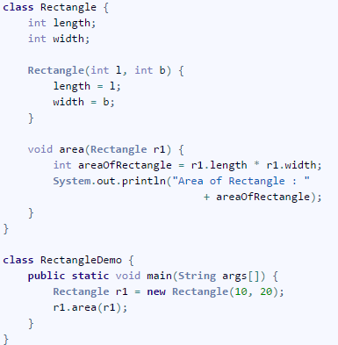
Different Ways of Passing Object as Parameter
1 : By directly passing Object Name

Slide 51
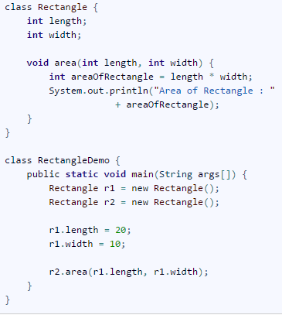
2. By passing Instance Variables one by one

Slide 52
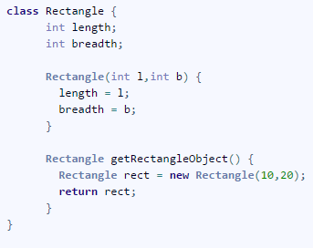
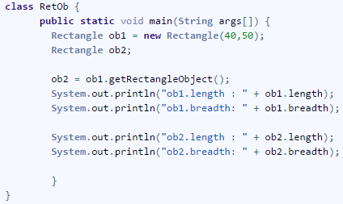
Returning the Object From Method
In Java Programming A method can return any type of data, including class types that you create.

Slide 53
Recursion in Java
Recursion in java is a process in which a method calls itself continuously. A method in java that calls itself is called recursive method.
returntype methodname()
{
//code to be executed
methodname(); //calling same method
}

Slide 54
Java Recursion Example
public class RecursionExample
{
static int count=0;
static void p()
{
count++;
if(count<=5){
System.out.println("hello "+count);
p();
}
}
public static void main(String[] args)
{
p();
}
}

Slide 55
Java Command Line Argument
The java command-line argument is an argument to passed the value at the time of running the java program.
The arguments passed from the console can be received in the java program and it can be used as an input.
So, it provides a convenient way to check the behavior of the program for the different values. You can pass N (1,2,3 and so on) numbers of arguments from the command prompt.

Slide 56
Program of Command Line Arguments
class CommandLineExample
{
public static void main(String args[])
{
System.out.println("Your first argument is: "+args[0]);
}
}
class A{
public static void main(String args[])
{
for(int i=0;i<args.length;i++)
System.out.println(args[i]);
}
}

Slide 57
Parse Method
Used to convert command line arguments which are in string format into a number( 0,1,2,3,…N) ” .
PARSE : It is a method which take a string(input) as an argument and convert in other formats as like :
1.Integer
2.Float
3.Double
THE TYPES OF PARSE METHODS :
1.parseInt();
2.parseDouble();
3.parseFloat();

Slide 58
Syntax: ParseInt()
Integer.parseInt(String s);
Float.parseFloat(String s);
Double.parseDouble(String s);
Example1:
String s=”156″; //156 is not a number it is string; System.out.println(s+1); //output:1561 :”156″+1=1561 string concatenation.
int x=Integer.parseInt(“156”);
System.out.println(x+1); //output:157 :156+1=157

Slide 59
Without Parse Method
With Parse Method
public class WithParseMethod {
public static void main(String[] args)
{
int a= Integer.parseInt(args[0]);
float b=Float.parseFloat(args[1]);
double c=Double.parseDouble(args[2]);
String s= args[3];
System.out.println(a+1);
System.out.println(b+1);
System.out.println(c+1);
System.out.println(s);
}
}
public class WithoutParseMethod {
public static void main(String[] args)
{
System.out.println(args[0]+1);
System.out.println(args[1]+1);
}
}

